Slide 1
ABAC for Role Activation Problem in Java Web App

Slide 2




What we used
Apache Directory Studio
•
Apache Maven
Apache Tomcat
Apache Fortress
Java

Slide 3

How do we ensure that our software is free of vulnerabilities?

Slide 4
The Solution (Take 1)
Perform software vulnerability scans. https://www.owasp.org/index.php/OWASP_
Dependency_Check

Slide 5
OWASP Vulnerability Scanning
Add to your Maven pom.xml file:
<plugin>
<groupId>org.owasp</groupId>
<artifactId>dependency-check-maven</artifactId>
<version>3.3.1</version>
<configuration>
<failBuildOnAnyVulnerability>true</failBuildOnAnyVulnerability>
<suppressionFile>${project.basedir}…/suppression.xml</suppressionFile>
</configuration>
</plugin>

Slide 6
How do we ensure that our software is free of vulnerabilities yet to be detected?
It practically can’t be done.

Slide 7
The Solution (Take 2)
Follow the best Security practices
- Back to our security principles

Slide 8
So Now What?
“Security best practices dictate that this
user have as
little privilege as possible
little privilege as possible
on the server itself, since security vulnerabilities in web applications and
web servers are so commonly exploited.”

Slide 9
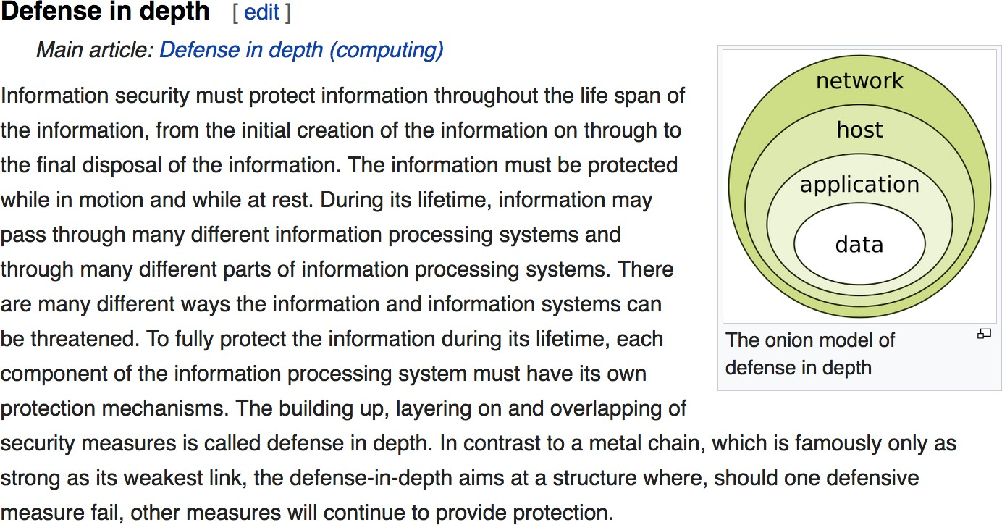
https://en.wikipedia.org/wiki/Information_security
The building up, layering on and overlapping of
security measures is called defense in depth. In contrast to a metal chain, which is famously
only as strong as its weakest link, the defense-in-depth aims at a structure where, should one
defensive measure fail, other measures will continue to provide protection.

Slide 10
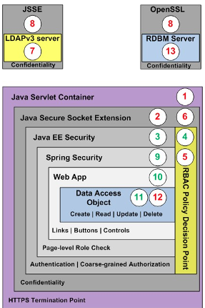

Java Web Security Layers
Java SE Security
Java Secure Socket Extension (JSSE)
Java EE Security
Spring Security
Web App Framework
Database Framework

Slide 11
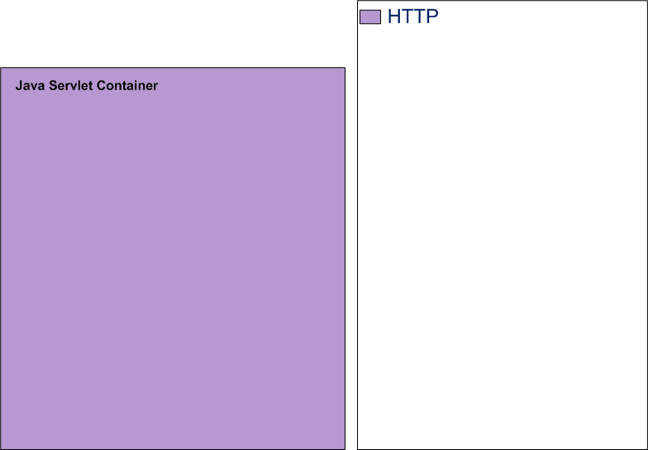

Start with Tomcat Servlet Container

Slide 12
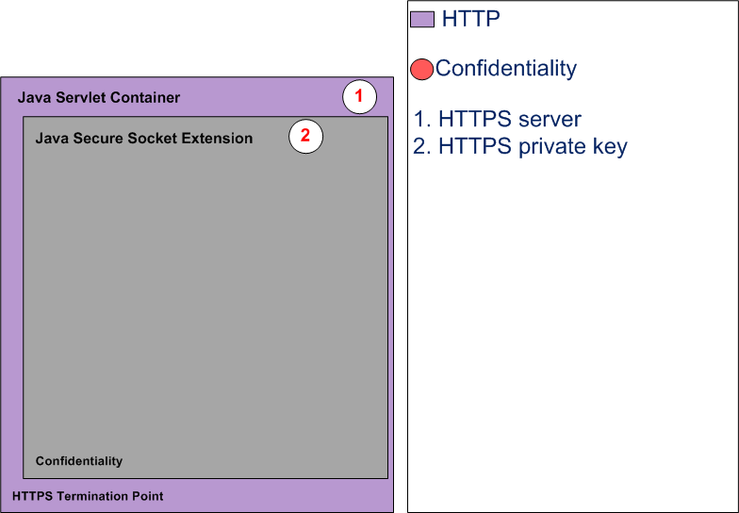

ssssh!!!
1 & 2. Enable HTTPS
Update the
Server.xml
Add private key

Slide 13
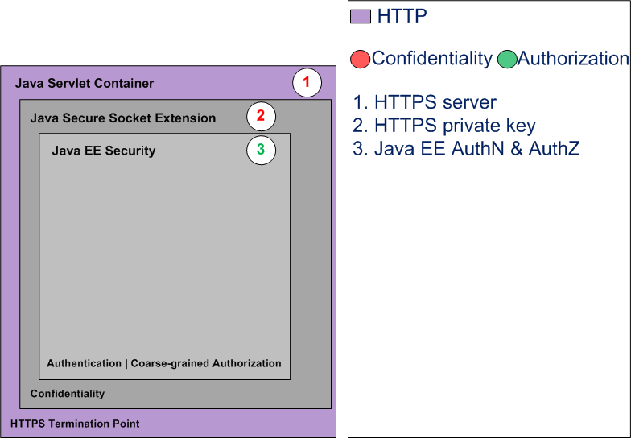

3. Enable Java EE Security
Update web.xml
Drop the proxy jar
Add context.xml
Add fortress to pom.xml

Slide 14

Current Specs for Java EE Security
JSR-196 – JASPIC - AuthN
JSR-115 – JAAC - AuthZ
JSR-375 – JavaEE Security API

Slide 15
What is a Realm?
A Realm is a "database" of usernames and passwords that identify valid users of a web application (or set of web applications), plus an enumeration of the list of roles associated with each valid user.
https://tomcat.apache.org/tomcat-9.0-doc/realm-howto.html

Slide 16
We use LDAP to access our Fortress Realm

Slide 17
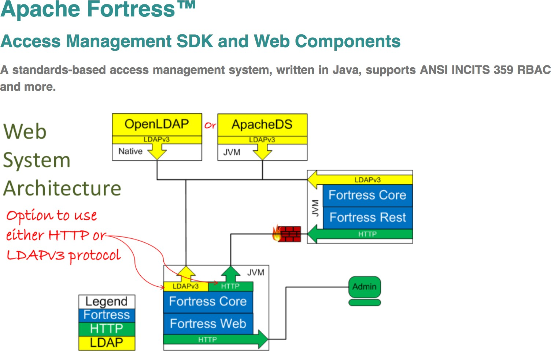

Slide 18
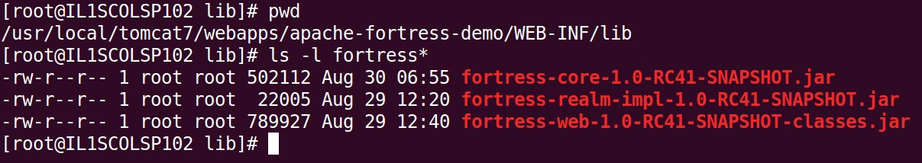
Add Fortress Realm Dependency
Add Fortress Dependency to web app’s pom.xml:
<dependency>
<groupId>org.apache.directory.fortress</groupId>
<artifactId>
fortress-realm-impl
</artifactId>
<version>2.0.0</version>
</dependency>

Slide 19
Enable Fortress Context Realm
Add context.xml to META-INF folder:
<Context reloadable="true">
<
Realm className=
“org.apache.directory.fortress.realm.tomcat.Tc7AccessMgrProxy"
defaultRoles=“ROLE_PAGE1,ROLE_PAGE2,
ROLE_PAGE3,…“
contextId=“tenant314"
/>
</Context>

Slide 20
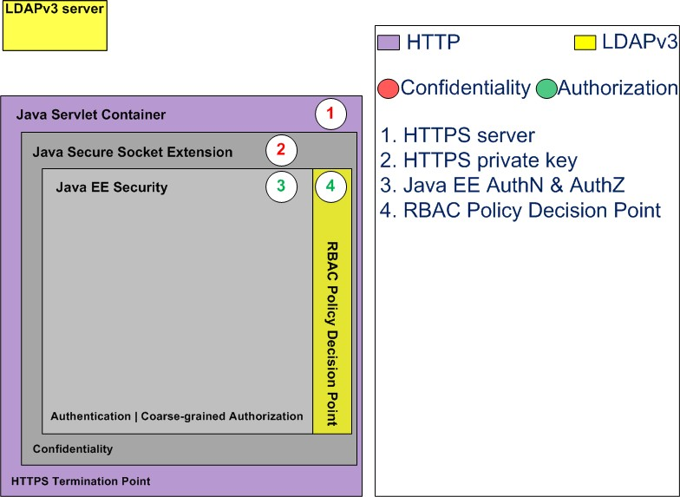
the security system
4. Setup Policy Decision Point

Slide 21
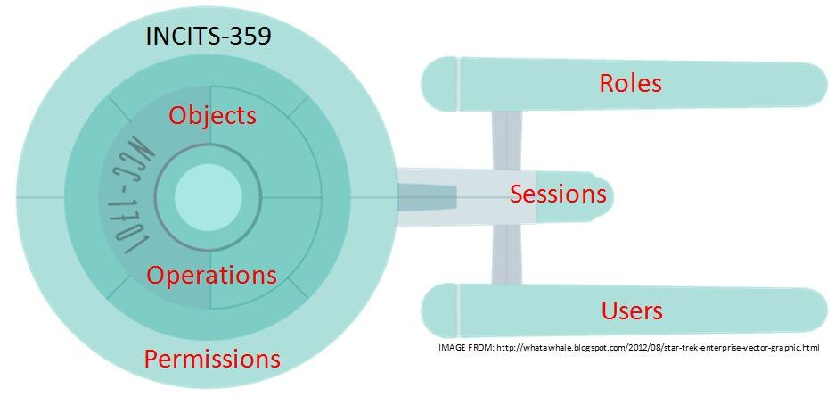
Intro to the RBAC Standard

Slide 22
RBAC
Role-based access control (RBAC) restricts network access based on a person's role within an
organization and has become one of the main methods for advanced access control. The roles in RBAC refer to the levels of access that employees have to the network.

Slide 23
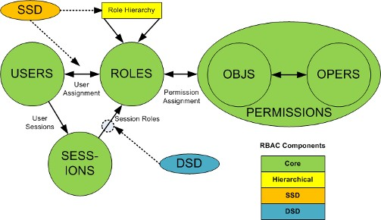
ANSI RBAC INCITS 359 Specification
RBAC0:
Users, Roles, Perms, Sessions
RBAC1:
Hierarchical Roles
RBAC2:
Static Separation of Duties
RBAC3:
Dynamic Separation of Duties
Today we demo this
x

Slide 24
Current Years
INCITS 359-2012 RBAC also known as Core.
INCITS 494-2012 RBAC Policy Enhanced allows attribute modifiers on permissions specifically to provide support for fine-grained authorization.

Slide 25
RBAC Object Model
Six basic elements:
User – human or machine entity
Role – a job function within an organization
Object – maps to system resources
Operation – executable image of program
Permission – approval to perform an Operation on one or more Objects
Session – contains set of activated roles for User

Slide 26
RBAC Functional Model
APIs form three standard interfaces:
Management and Config processes
Admin – Add, Update, Delete
Review – Read, Search
3.
System – Access Control
x
runtime
processes

Slide 27
RBAC Functional Model
System Manager APIs:
createSession – authenticate, activate roles
checkAccess – permission check
sessionPermissions – all perms active for user
sessionRoles – return all roles active
addActiveRole – add new role to session
dropActiveRole – remove role from session

Slide 28
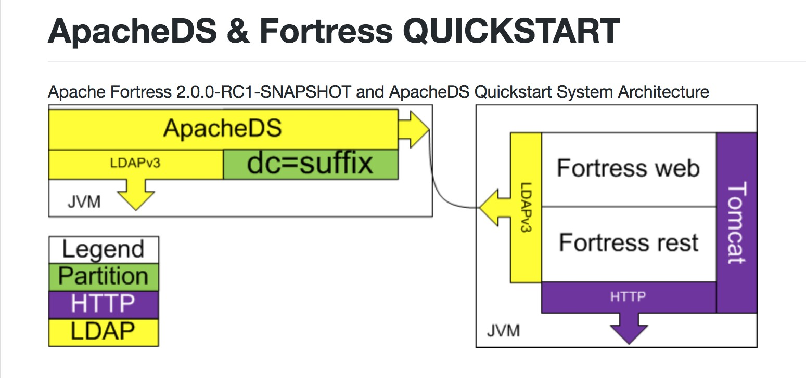



Slide 29
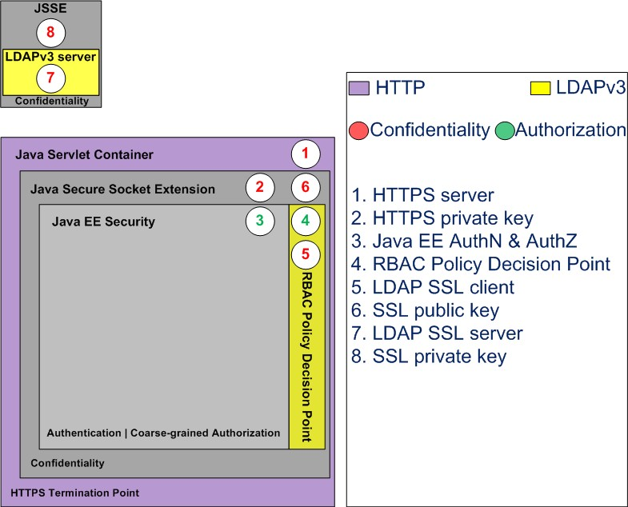
confidentiality
5 – 8
Enable LDAP SSL

Slide 30
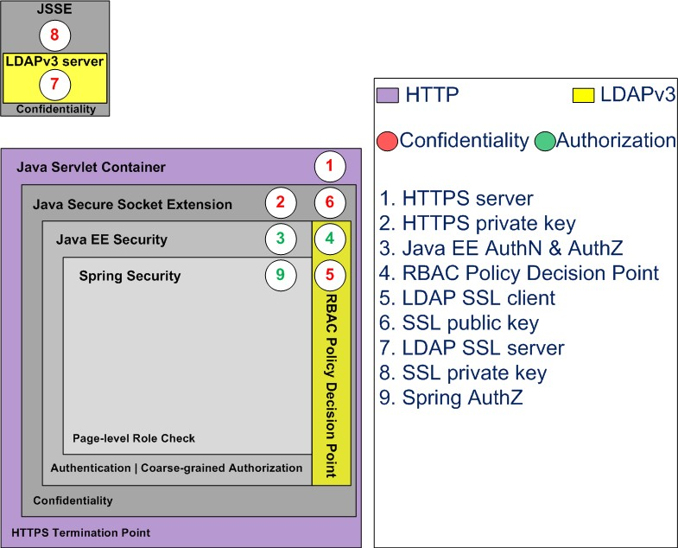

9. Enable Spring Security
locks on the rooms
Authorization
Role mapping

Slide 31
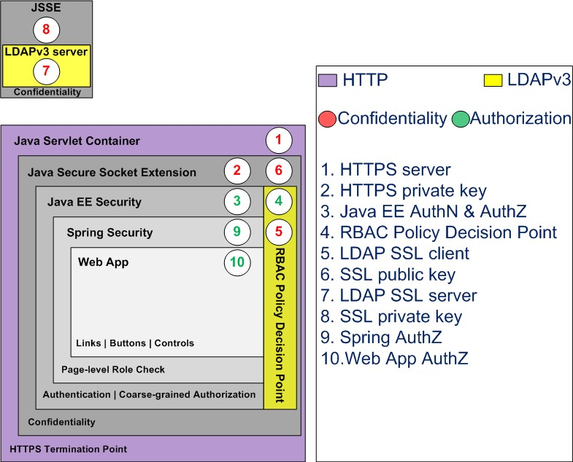

locks on equipment
10. Web App Authorization
Add fine-grained
checks:
Page links
Buttons
Other controls

Slide 32
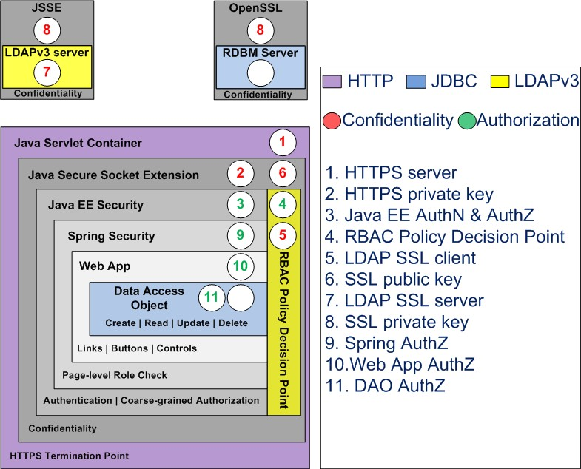

11. DAO Authorization
filtering
Add fine-grained
Checks to:
Create
Read
Update
Delete

Slide 33
App Demo
Three Pages and Three Customers
One role for every page to customer combo
Users may be assigned to one or more roles
One and only one role may be activated
Pages | Customer 123 | Customer 456 | Customer 789
Page One | PAGE1_123 | PAGE1_456 | PAGE1_789
Page Two | PAGE2_123 | PAGE2_456 | PAGE2_789
Page Three | PAGE3_123 | PAGE3_456 | PAGE3_789

Slide 34
User123 | Customer 123 | Customer 456 | Customer 789
Page1 | True | False | False
Page2 | True | False | False
Page3 | True | False | False
User1 | Customer 123 | Customer 456 | Customer 789
Page1 | True | True | True
Page2 | False | False | False
Page3 | False | False | False
User1_123 | Customer 123 | Customer 456 | Customer 789
Page1 | True | False | False
Page2 | False | False | False
Page3 | False | False | False

Slide 35
User456 | Customer 123 | Customer 456 | Customer 789
Page1 | False | True | False
Page2 | False | True | False
Page3 | False | True | False
User2 | Customer 123 | Customer 456 | Customer 789
Page1 | False | False | False
Page2 | True | True | True
Page3 | False | False | False
User2_123 | Customer 123 | Customer 456 | Customer 789
Page1 | False | True | False
Page2 | False | False | False
Page3 | False | False | False

Slide 36
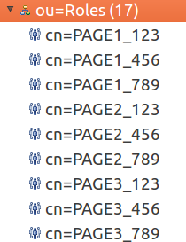
We still have a problem…

Slide 37
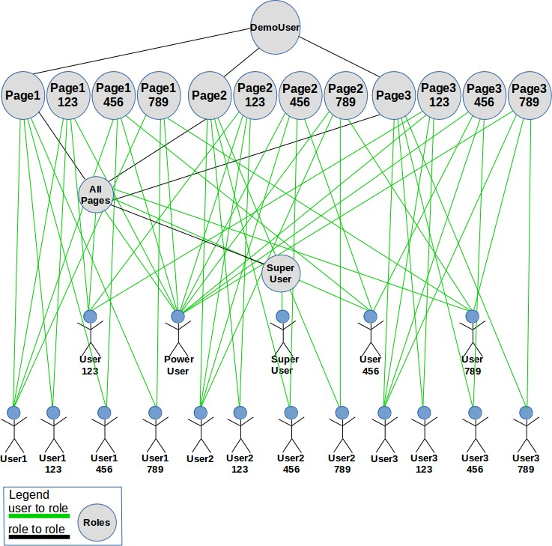
Roles Have Exploded

Slide 38
Cartesian Product
A x B = {(a,b) | a ∈ A and b ∈ B}
–A : role
–B : relationships

Slide 39
Number of Roles = sizeof(A) * sizeof(B)
Roles
1. Page1-123
2. Page1-456
3. Page1-789
4. Page2-123
5. Page2-456
6. Page2-789
7. Page3-123
8. Page3-456
9. Page3-789
Roles (A) Page1 Page2
Relationships (B)
Customer 123
Customer 456
Customer 789
=>
*
Page3

Slide 40
RBAC
only
Roles Page1_123 Page1_456 Page1_789 Page2_123 Page2_456 Page2_789 Page3_123 Page3_456 Page3_789
Poweruser

Slide 41
The Solution
Using ABAC Here
Use attributes to constrain under what conditions roles may be activated.

Slide 42
RBAC w/ ABAC
Users
Constraints
Page1 : 123
Page1 : 456
Page1 : 789
Page2 : 123
Page2 : 456
Page2 : 789
Page3 : 123
Page3 : 456
Page3 : 789
Roles Page1 Page2 Page3
User1-123
User1-456
User1-789
User2-123
User2-456
User2-789
User3-123
User3-456
User3-789

Slide 43
RBAC w/ ABAC
User1
Page1 : 123, 456, 789, …
Page1 : 123
Page2 : 123,
Page3 : 123
Roles Page1 Page2 Page3
User123
User2
Page2 : 123, 456, 789, …
Page1 : 456
Page2 : 456
Page3 : 456
User456
User3
Page3 : 123, 345, 789, …
Page1 : 789
Page2 : 789
Page3 : 789
User789

Slide 44
RBAC w/ ABAC
Roles Page1 Page2 Page3
Page1 : 123, 456, 789, …
Page2 : 123, 456, 789, …
Page3 : 123, 345, 789, …
Poweruser 

Slide 45

Under the Hood

Slide 46
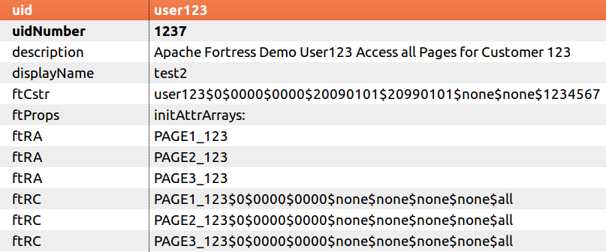
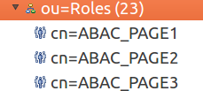
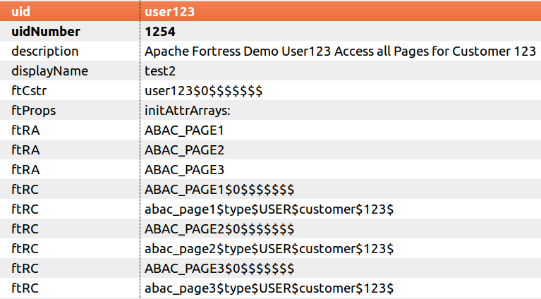

RBAC
only
RBAC
w/ ABAC
After ABAC

Slide 47
Role Constraints
<roleconstraint role=“PAGE1" key="customer" … />
<roleconstraint role=“PAGE2" key="customer" … />
<roleconstraint role=“PAGE3" key="customer" … />
77

Slide 48
User-Role Constraints
<roleconstraint userId="User123" role=“PAGE1" key="customer" value="123“ … />
<roleconstraint userId="User123" role=“PAGE2" key="customer" value="123“ … />
<roleconstraint userId="User123" role=“PAGE3" key="customer" value="123" … />
78

Slide 49
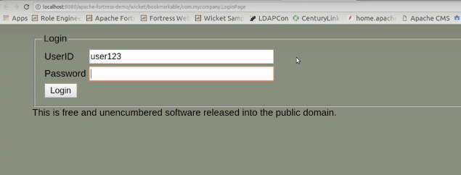

OUTPUT

Slide 50
User123 | Customer 123 | Customer 456 | Customer 789
Page1 | True | False | False
Page2 | True | False | False
Page3 | True | False | False
User1 | Customer 123 | Customer 456 | Customer 789
Page1 | True | True | True
Page2 | False | False | False
Page3 | False | False | False
User1_123 | Customer 123 | Customer 456 | Customer 789
Page1 | True | False | False
Page2 | False | False | False
Page3 | False | False | False

Slide 51
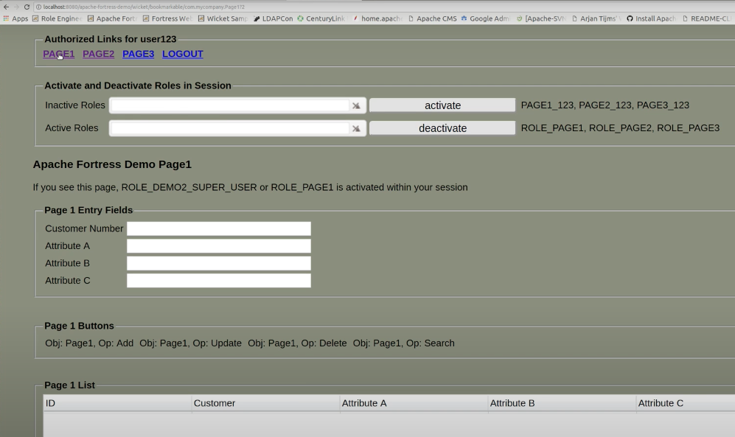
OUTPUT

Slide 52
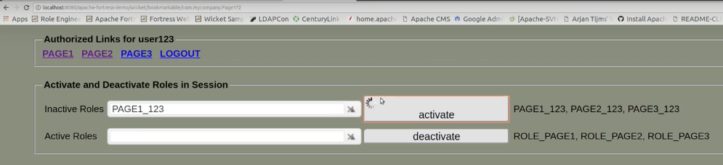
OUTPUT

Slide 53
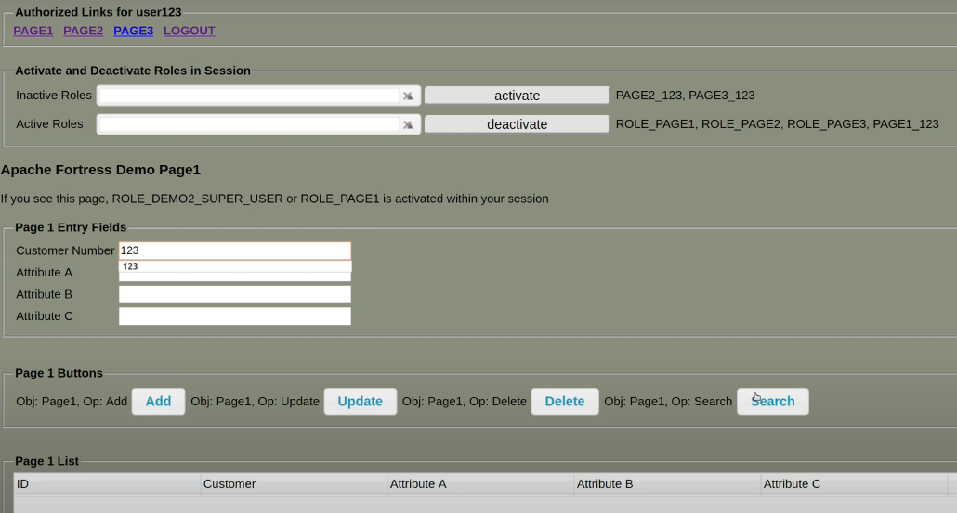
OUTPUT

Slide 54
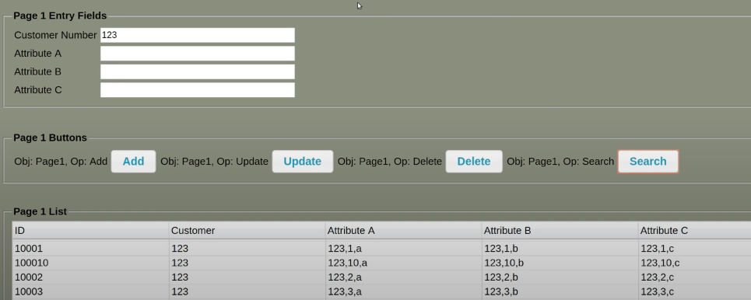
OUTPUT

Slide 55
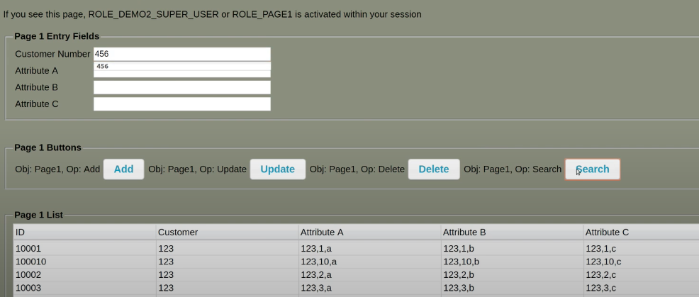
OUTPUT

Slide 56
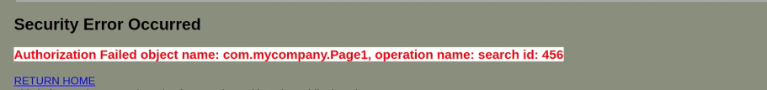
OUTPUT

Slide 57
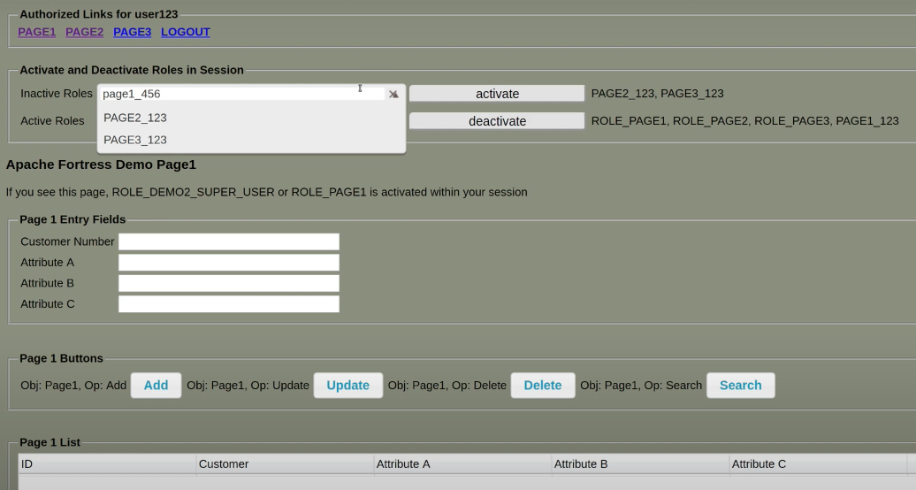
OUTPUT

Slide 58
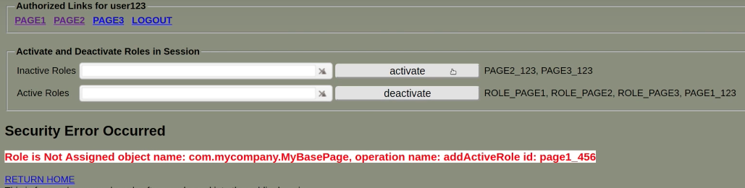
OUTPUT

Slide 59
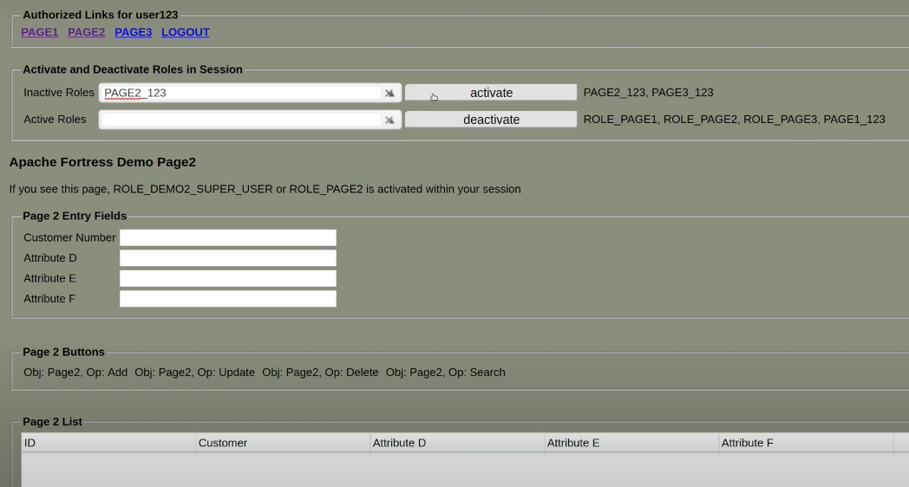
OUTPUT

Slide 60
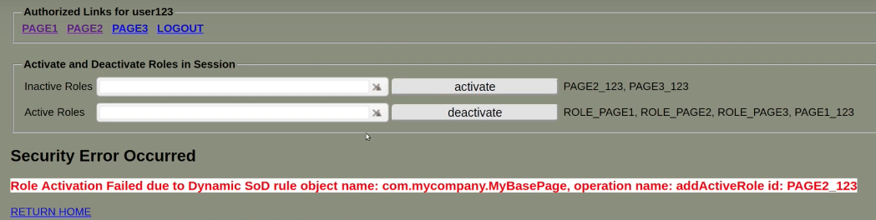
OUTPUT

Slide 61
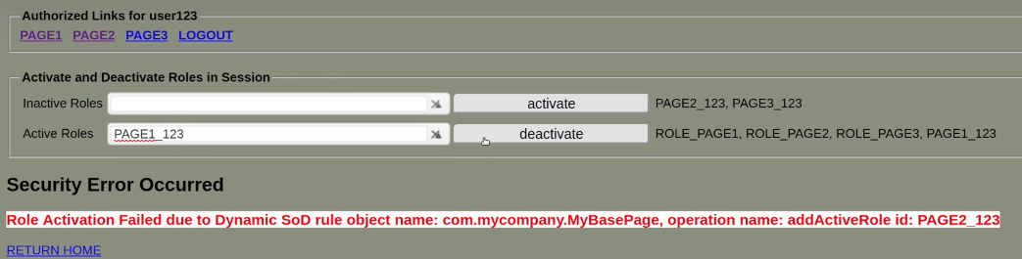
OUTPUT

Slide 62
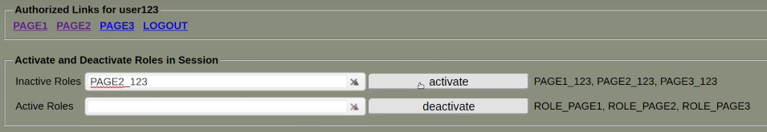
OUTPUT

Slide 63
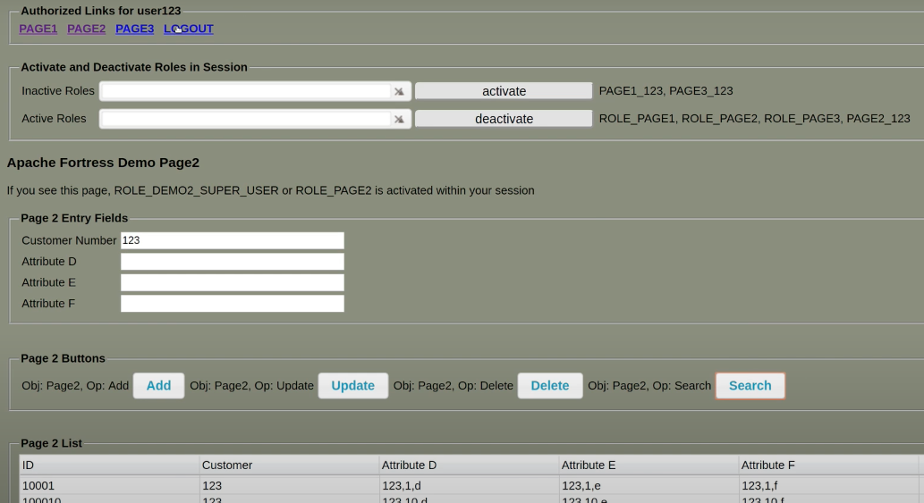
OUTPUT

Slide 64
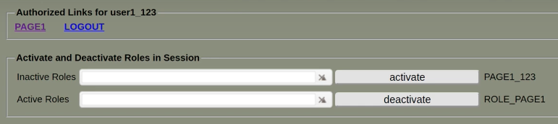
OUTPUT

Slide 65
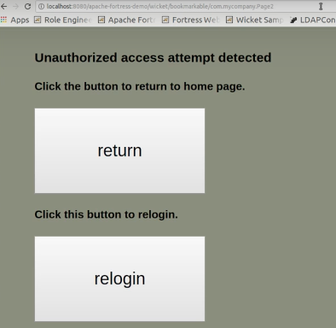
OUTPUT

Slide 66
Closing Points
Never allow users more than they need to do their jobs
Principle of Least Privilege
Apply security controls across many layers
Defense in Depth
RBAC may be combined with ABAC
Fine-grained Authorization

Slide 67

THANK YOU!

